Slide 1
Adversarial Attacks on Battery Energy Storage Systems Using Physics-Based Models in PyBaMM
Harrison Faure Alaa Selim Huadong Mo | z5364422

Slide 2


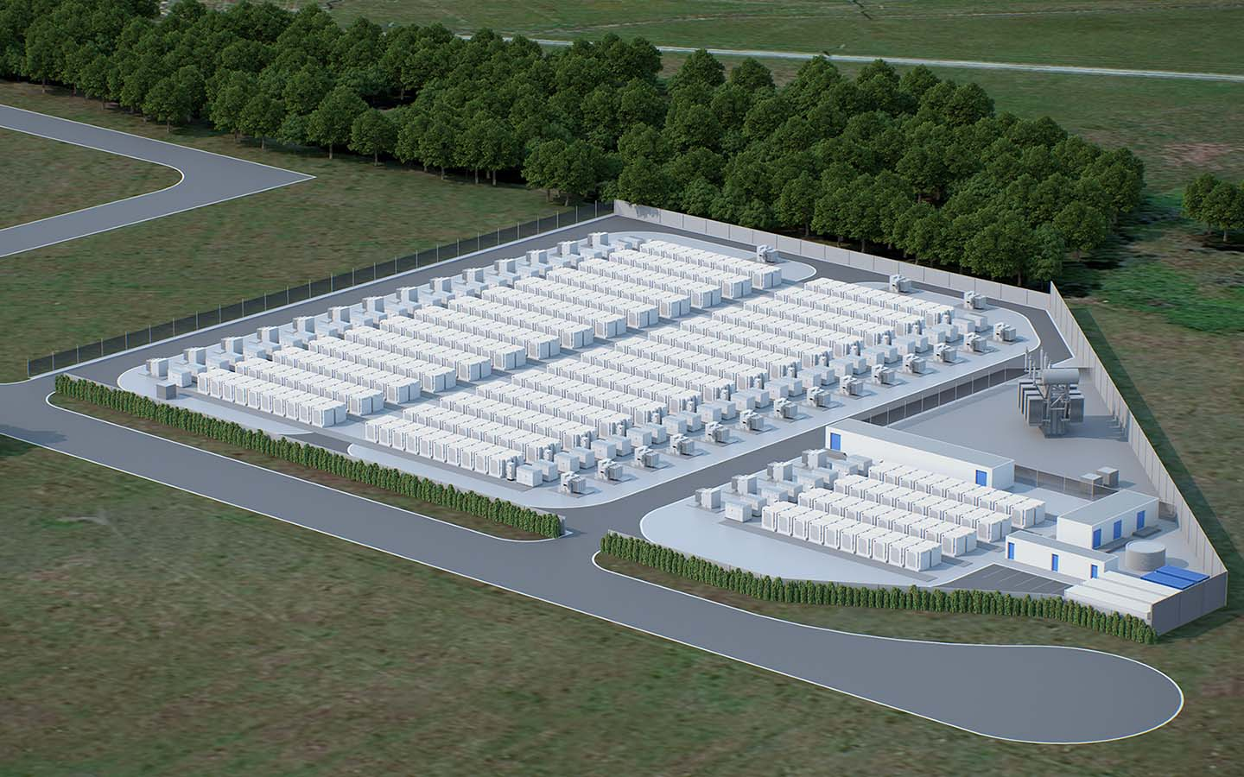

Motivation
Range Bank BESS. "Range Bank Battery Energy Storage System," 2023. Available: https://www.rangebankbess.com
Bank Info Security. "US Officials Blame Election Data Theft on Russian APT Group," 2023. Available: https://www.bankinfosecurity.com/us-officials-blame-election-data-theft-on-russian-apt-group-a-15231
Industrial Cyber. "DHS Warns of Escalating Threats to US Critical Infrastructure in 2025 Homeland Threat Assessment," 2023. Available: https://industrialcyber.co/threat-landscape/dhs-warns-of-escalating-threats-to-us-critical-infrastructure-in-2025-homeland-threat-assessment/
Cyber.gov.au. "Russian Military Cyber Actors Target US and Global Critical Infrastructure," Australian Cyber Security Centre, 2023. Available: https://www.cyber.gov.au/about-us/view-all-content/alerts-and-advisories/russian-military-cyber-actors-target-us-and-global-critical-infrastructure

Slide 3
Importance
Combines physics-based (PyBaMM) and ML models.
Addresses Cyber-physical vulnerabilities.
Enhances prediction of SoC and SoH under adversarial conditions in real-world scenarios.
Increases the resilience of BESS for renewable energy grids and electric vehicles.
V. Obrien, R. D. Trevizan, and V. S. Rao, “Detecting false data injection attacks to battery state estimation using cumulative sum algorithm,” in 2021 North American Power Symposium (NAPS). IEEE, 2021, pp. 01–06.
A. Sayghe, J. Zhao, and C. Konstantinou, “Evasion attacks with adversarial deep learning against power system state estimation,” in 2020 IEEE Power & Energy Society General Meeting (PESGM). IEEE, 2020, pp. 1–5.
Z. Khalik, M. Donkers, and H. J. Bergveld, “Model simplifications and their impact on computational complexity for an electrochemistry-based battery modeling toolbox,” Journal of Power Sources, vol. 488, p. 229427, 2021.
R. D. T. V. Obrien, “Cyber security of battery energy storage systems,” IEEE Access, 2021.
D. D. A. Selim, H. Mo, “Advanced battery management systems,” Journal of Power Sources, vol. 478, 2023.

Slide 4
Current Gaps
Limited focus on adversarial attacks
Physics-Based Models
Machine Learning Vulnerabilities
S. Vignesh, H. S. Che, J. Selvaraj, K. S. Tey, J. W. Lee, H. Shareef, and R. Errouissi, “State of Health (SoH) Estimation Methods for Second Life Lithium-ion Battery—Review and Challenges,” Applied Energy, vol. 369, p. 123542, 2024.
M. Doyle, T. F. Fuller, and J. Newman, “Modeling of galvanostatic charge and discharge of the lithium/polymer/insertion cell,” Journal of the Electrochemical Society, vol. 140, no. 6, p. 1526, 1993.
M. Kaheni, E. Usai, and M. Franceschelli, “Resilient and privacy-preserving multi-agent optimization and control of a network of battery energy storage systems under attack,” IEEE Transactions on Automation Science and Engineering, 2023.
V. Obrien, R. D. Trevizan, and V. S. Rao, “Detecting false data injection attacks to battery state estimation using cumulative sum algorithm,” in 2021 North American Power Symposium (NAPS). IEEE, 2021, pp. 01–06.

Slide 5
Objectives
Analyse and interpret vulnerabilities in BESS.
Identify how adversarial attacks exploit weaknesses in battery systems
Understand the effects of targeted attacks on critical battery parameters
Advances in Electrical Engineering, Electronics and Energy.
Journal of Energy Storage
[7]

Slide 6
Doyle-Fuller-Newman (DFN) model
Model for simulating lithium-ion battery behaviour using electrochemical properties.
Provides detailed, physics-based representation of battery dynamics. Captures behaviours critical for attack simulation.
Describes electrolyte behaviour, lithium-ion concentration, and electrode potentials.
Create realistic attack scenarios of parameters like current, voltage, temperature, and SEI resistance.

Slide 7
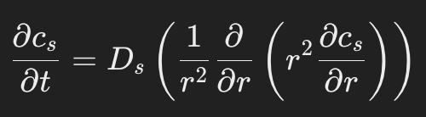
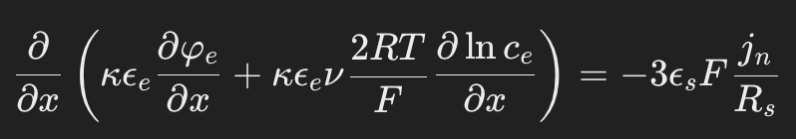
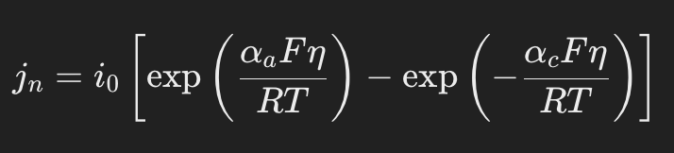
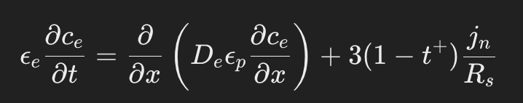
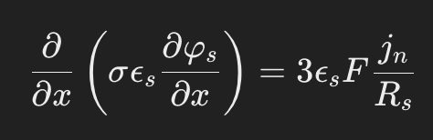
Key Equations
Solid-phase Lithium-ion Concentration (cs):
Electrolyte-phase Lithium-ion Concentration (ce):
Solid-phase Potential (ϕs):
Electrolyte-phase Potential (ϕe):
Butler-Volmer Kinetics (jn):
M. Doyle, T. F. Fuller, and J. Newman, "Modeling of galvanostatic charge and discharge of the lithium/polymer/insertion cell," Journal of the Electrochemical Society, vol. 140, no. 6, p. 1526, 1993.

Slide 8
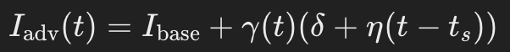
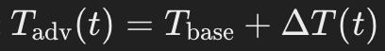
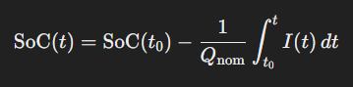
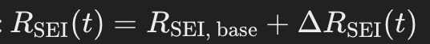
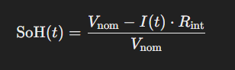
Simulating Adversarial Attacks
Current Attack
Temperature Attack
SEI Resistance Attack
State of Charge [SoC]
I(t) : Battery Current at time t
Q(nom): nominal capacity of the battery (Ah).
SoC(t0​): initial State of Charge.
State of Health [SoH]
V(nom): nominal voltage of the battery.
𝐼(𝑡): current.
𝑅(int)​: internal resistance.
S. Lee, J. Kim, J. Lee, and B.H. Cho, "State-of-charge and capacity estimation of lithium-ion battery using a new open-circuit voltage versus state-of-charge relationship," Journal of Power Sources, vol. 185, pp. 1367-1373, 2016.
S. Sepasi, R. Ghorbani, and B.Y. Liaw, "Inline state of health estimation of lithium-ion batteries using state of charge calculation," Journal of Power Sources, vol. 299, pp. 246-254, 2015.
V. Obrien, R. D. Trevizan, and V. S. Rao, "Detecting false data injection attacks to battery state estimation using cumulative sum algorithm," in 2021 North American Power Symposium (NAPS). IEEE, pp. 01–06, 2021.
R. D. Trevizan, J. Obert, V. De Angelis, T. A. Nguyen, V. S. Rao, and B. R. Chalamala, "Cyberphysical security of grid battery energy storage systems," IEEE Access, vol. 10, pp. 59675–59722, 2022.

Slide 9
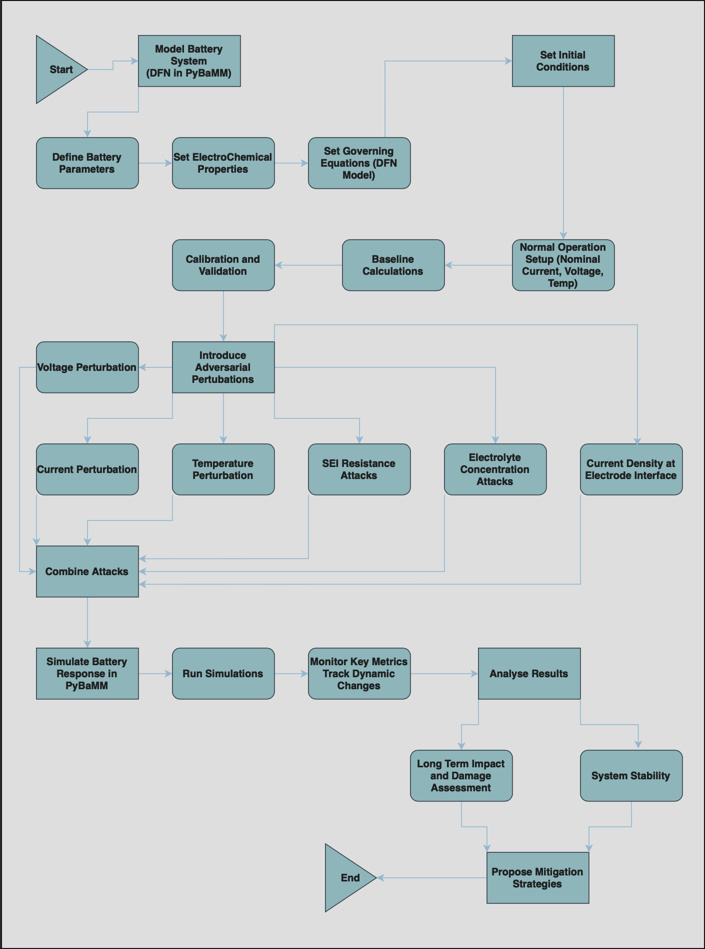
Methodology Part 1

Slide 10
Methodology Part 2

Slide 11
Methodology Part 3

Slide 12
Simulation Settings
Input Data
Setting | Value
Nominal Current | 2A discharge rate
Initial SoC | 80%
Temperature | 298.15K
Assumptions
Setting | Value
SEI resistance | 1 × 10⁻³ Ω·m² Baseline
Electrolyte concentration | uniform distribution
Attack Window
Setting | Value
Time | 1-2s
Gradual increase and decrease in attack intensity.

Slide 13
Data Input and Attack Parameters
Perturbation Amplitude
Parameter | Value
Current | Deviation 2x Current
Voltage | Deviation 0.01V
Temperature | Spike 301K
Time Window (Attack duration) | 1-2s
Optimisation Goals
Maximise deviation in terminal voltage
Maintain perturbations within safe operational limits
Optimisation Method
L-BFGS-B algorithm for bound-constrained optimization has been replaced with CasadiSolver

Slide 14
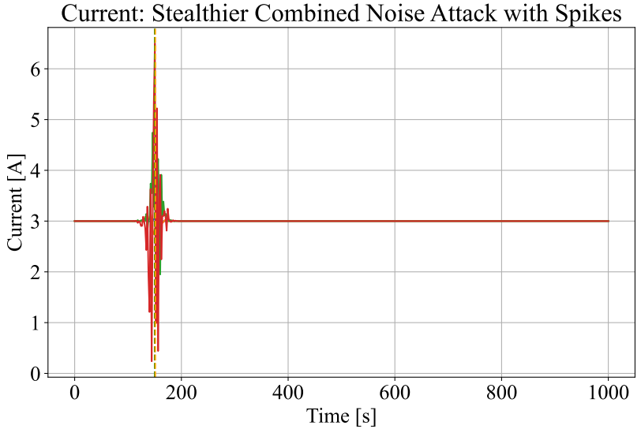
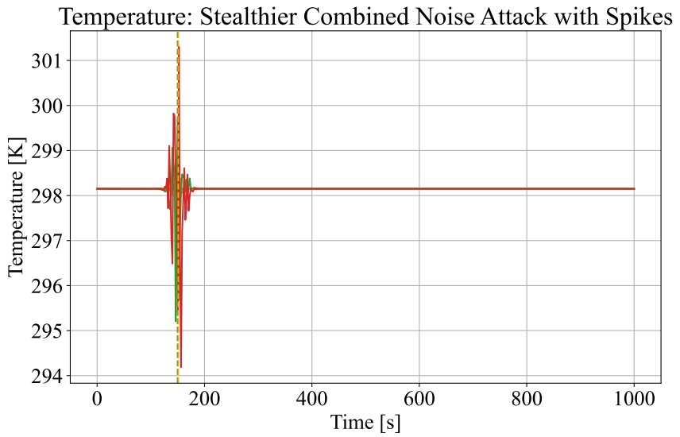
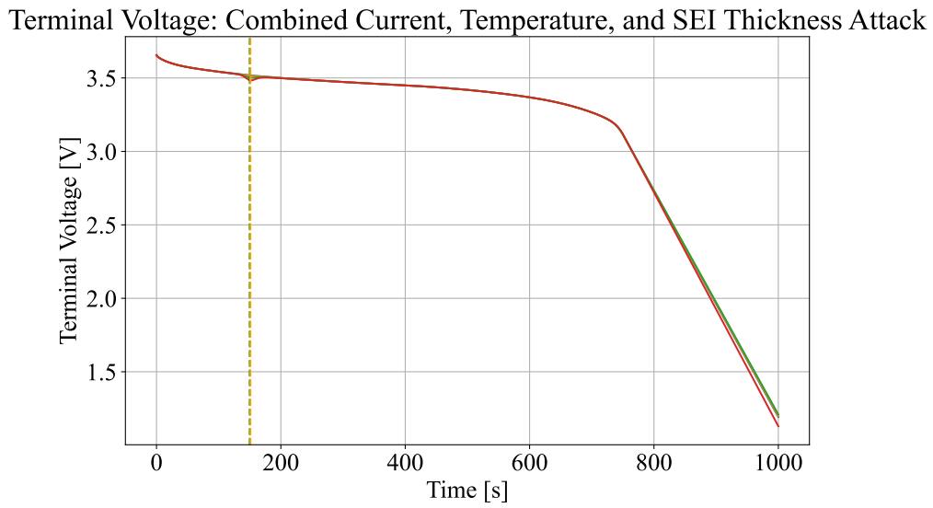
Results – Single Window | Combine Attack
No Attack
Attack

Slide 15
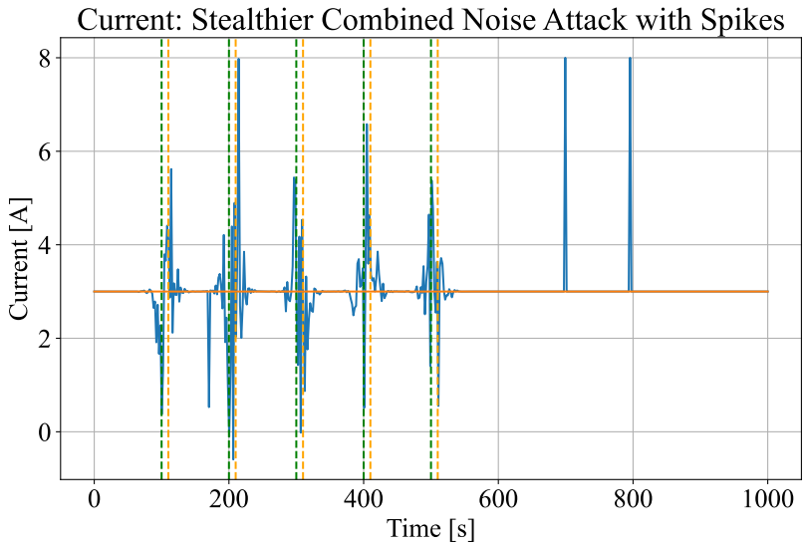
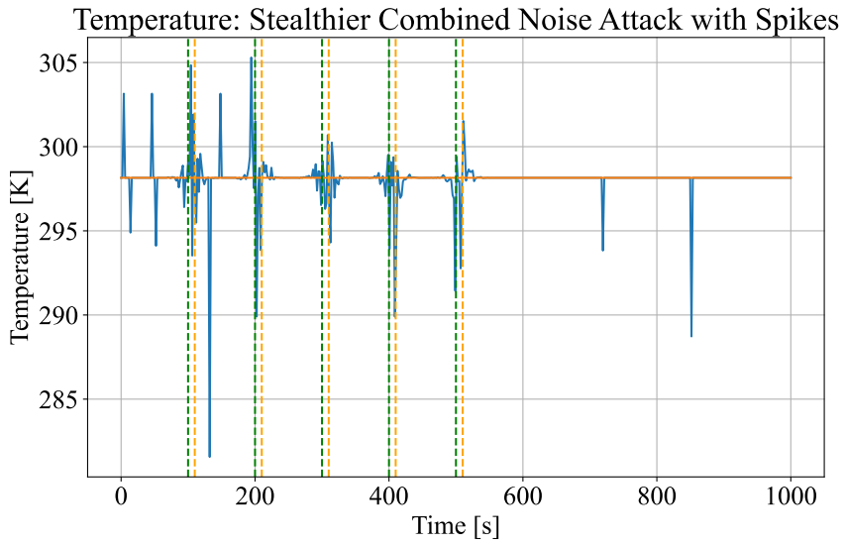
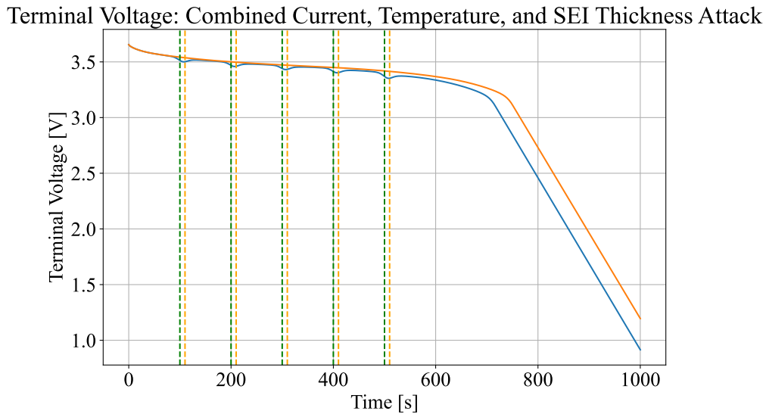
Results – Multiple Window | Combine Attack
No Attack
Attack

Slide 16
Critique Analysis
Voltage collapse due to adversarial attacks
Significant impact on SoC and SoH under attack conditions
Combined attacks on multiple sensors lead to cascading effects
Attack windows crucial in understanding attack severity
[7]

Slide 17
Future Research
Real-time Detection
Expand to Other Chemistries
Enhance Model Robustness

Slide 18
Conclusion
Disrupt key metrics
Need for Better Defences
Future-proofing Battery Management Systems
Ensure long-term stability and safety of energy storage systems

Slide 19
Q & A

